Slide 1
WSUP18-0001 Ax Handle Canyon
Washoe County Board of Adjustment
April 5, 2018

Slide 2
Overview
General Rural Agriculture – Cell Tower permitted by SUP
Fill a gap in coverage in the Warm Springs and Spanish Springs area
Major grading required for utility access road
Unmanned facility located in rural area
Will be visible from road, but does not extend above ridge line
No other towers in the area

Slide 3
Surrounding Area

Slide 4
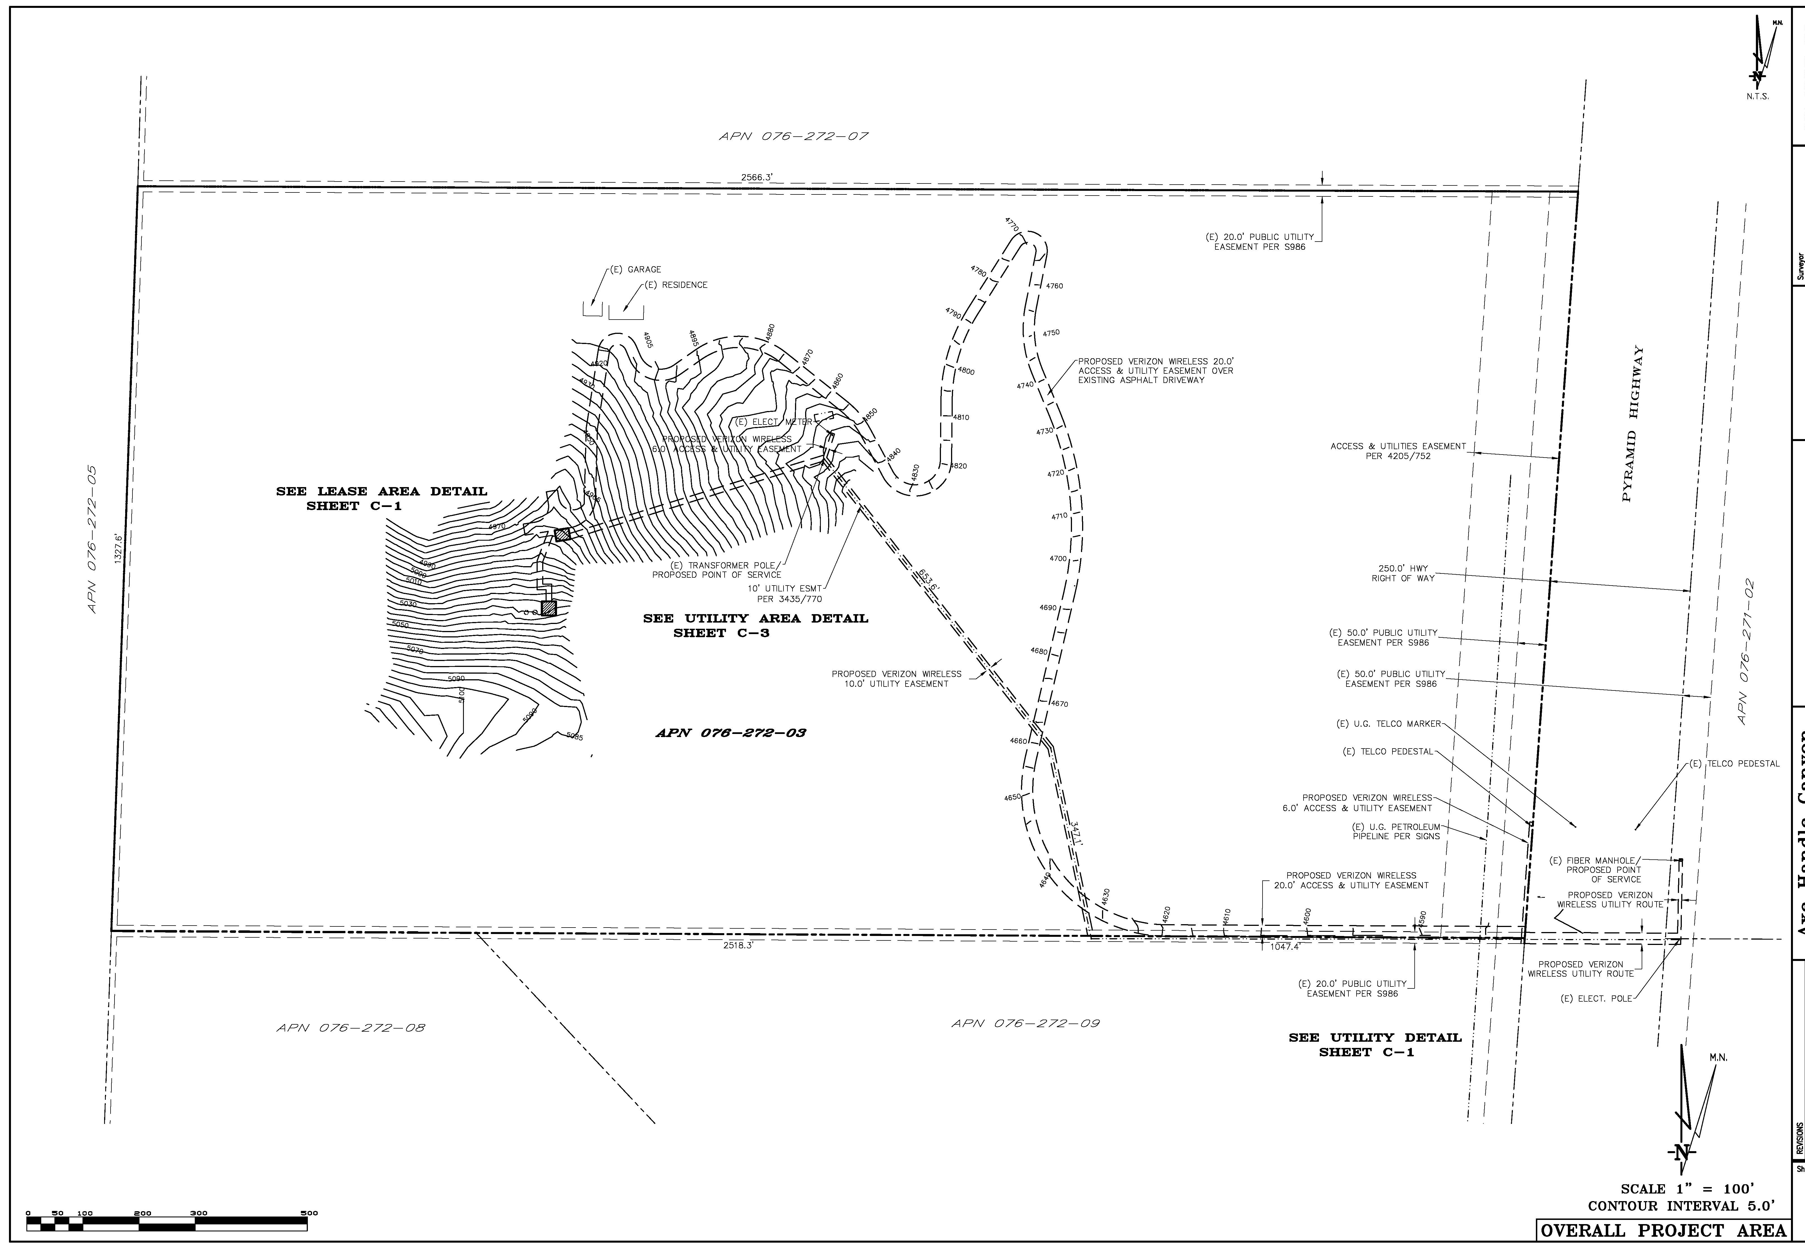
Site Plan

Slide 5
Request
Construct and operate 104’ tall monopole with supporting equipment
Major grading to build access to the lease areas
Vary Parking and Landscaping requirements
Vary grading requirement (Condition 2.d.) – to allow slopes in excess of 3:1 at the discretion of the County Engineer

Slide 6
Proposed Amended Condition
2.d. Per the grading code, grading shall not result in slopes in excess of, or steeper than, three horizontal to one vertical (3:1).
2.d. Slopes in excess of, or steeper than, three horizontal to one vertical (3:1) may be permitted at the discretion of the County Engineer for the utility access road.

Slide 7
Public Notice & CAB
Warm Springs/Rural Citizen Advisory Board
39 property owners within 750 foot radius
No comments received

Slide 8
Reviewing Agencies
Washoe County Community Service
Planning and Building Division
Engineering and Capital Projects
Washoe County Health District
Air Quality Management Division
Environmental Health Services Division
Regional Transportation District
Truckee Meadows Fire Protection District
Washoe-Story Conservation District
Palomino Valley General Improvement District
Bureau of Land Management

Slide 9
Special Use Permit Findings
1. Consistency
2. Improvements
3. Site Suitability
4. Issuance Not Detrimental
5. Effect on a Military Installation
6. Sections 110.324.40 through 110.324.60 Requirements
7. Public input was considered
8. Will not unduly impact the adjacent neighborhoods or the vistas and ridgelines of the County.

Slide 10
Possible Motion
I move that, after giving reasoned consideration to the information contained in the staff report and information received during the public hearing, the Washoe County Board of Adjustment approve, subject to the conditions contained in Exhibit A to the staff report, (amending condition 2.a.) Special Use Permit Case Number WSUP18-0001 for Verizon Wireless, having made all eight findings in accordance with Washoe County Code Section 110.810.30 and 110.324.75:

